Slide 1
SSPI TAXEVA Indicator
Analyzing Countries’ Corporate Tax Evasion Allowance

Slide 2
Objectives
Not enough data from Tax Justice Network (TJN) on Tax Haven Index…
What other data exists which could serve as a reasonable proxy to this policy?

Slide 3
Overview of 2021 Paper
Ending Corporate Tax Avoidance and Tax Competition: A Plan to Collect the Tax Deficit of Multinationals (Saez et al., 2021)

Slide 4
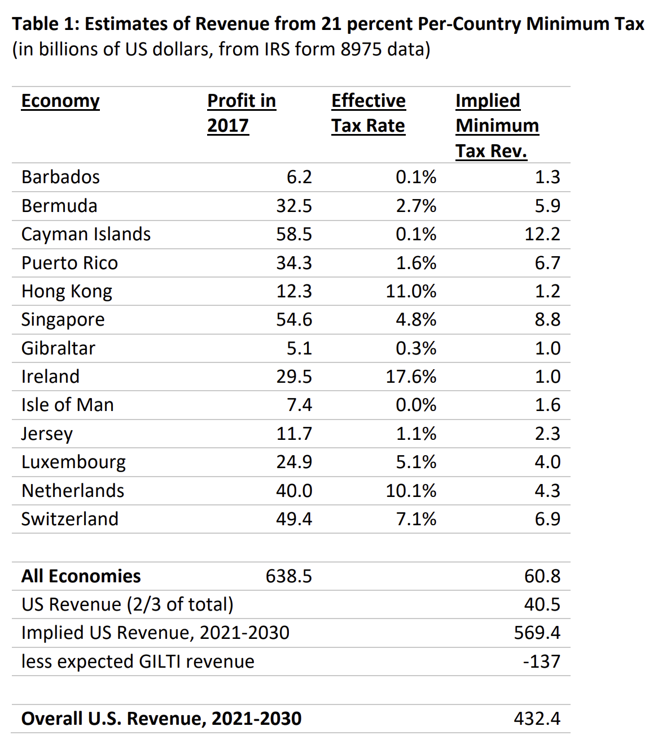
Overview of 2021 Paper

Slide 5
IRS Form 8975
Annual country-by-country reporting is required by certain U.S. persons that are the ultimate parent entity of a U.S. multinational enterprise (MNE) group with annual revenue for the preceding reporting period of $850,000,000 or more.

Slide 6
SOI Tax Statistics - Country-by-Country Report
Data are taken from Form 8975 - Country-by-Country Report
Multiple data sources, but will focus on Country-by-Country Report (Form 8975): Tax Jurisdiction Information (Schedule A: Part I) by Effective Tax Rate of Multinational Enterprise Sub-groups, Major Geographic Region, and Selected Tax Jurisdiction
Data available for 2017 - 2021

Slide 7
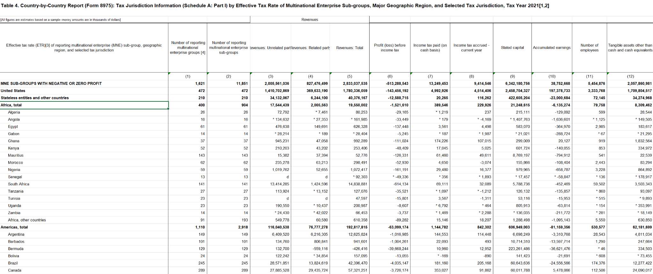
Snippet of Dataset

Slide 8
Overview of Data
1. Number of Reporting Multinational Enterprise Groups:
This column shows the number of MNC groups that have reported tax and financial data for a particular jurisdiction.

Slide 9
Overview of Data
2. Unrelated Party Revenues:
This column shows the total revenue generated by MNCs from transactions with external entities (i.e., companies or customers that are not affiliated with the MNC group).

Slide 10
Overview of Data
3. Related Party Revenues:
This column shows the revenue generated from intra-group transactions—business conducted between subsidiaries of the same MNC group, also known as transfer pricing.

Slide 11
Overview of Data
4. Profit Before Income Tax
This column represents the aggregate profit or loss generated by all MNCs in a given jurisdiction before any taxes are applied.

Slide 12
Overview of Data
5. Income Tax Paid (on Cash Basis)
Total amount of tax actually paid by MNCs in cash during the reporting period, regardless of when the taxes were accrued.

Slide 13
Overview of Data
7. Income Tax Accrued - Current Year
This is the total amount of income tax that MNCs expect to pay for the current year, though it may not have been paid yet.

Slide 14
Overview of Data
8. Stated Capital
This reflects the aggregate capital invested by all MNCs in a particular jurisdiction, including equity and retained earnings.

Slide 15
Overview of Data
9. Accumulated Earnings
This column shows the total retained profits that have been accumulated by MNCs in a particular jurisdiction and not yet distributed or repatriated.

Slide 16
Overview of Data
10. Number of Employees
11. Tangible Assets (Other than Cash)
This column shows the total value of tangible assets (like property, plants, and equipment) held by MNCs in a jurisdiction, excluding cash and equivalents.

Slide 17
Ideas on Identifying Features to Determine Tax Evasion
1. Proportion of related party revenue relative to total revenue: the greater the proportion, the more likely it is this country is a tax haven.
2. If the country has low total income tax paid (on cash basis), yet its profit before income tax is high, this suggests base erosion. Likewise, if the country has high total income tax paid (on cash basis), but its profit before income tax is low (or is a loss).
3. If the income tax accrued is (consistently) higher than the income tax paid, the country is more likely to be a tax haven
4. If the ratio of stated capital to number of employees is very low (on a logarithmic scale?) then this country is more likely to be a tax haven
5. If the country has low income tax paid (on cash basis) but high accumulated earnings, the country is more likely to be a tax haven
6. If the number of employees is small but the profit before income tax is high, the country is more likely to be a tax haven

Slide 18
Feature 1: Proportion of related party revenue relative to total revenue
A higher proportion of related party revenue (intra-group transactions) compared to total revenue could indicate that a country is being used as a conduit for profit shifting, since the revenue is largely flowing within the same company rather than from actual business activity.

Slide 19
Feature 2: Tax-to-Profit Ratio
If income tax paid (on a cash basis) is low relative to profit before income tax, this could indicate base erosion practices, where companies artificially reduce taxable income in high-tax countries to avoid taxes.

Slide 20
Feature 3: (Consistent) Difference between Income Tax Accrued and Paid
If income tax accrued is consistently higher than income tax paid, it may suggest deferred taxation or aggressive tax strategies to delay paying taxes.

Slide 21
Feature 4: Stated Capital-to-Employees Ratio
A low ratio of stated capital to employees suggests that while there may be substantial capital parked in the country, there are few employees, indicating minimal real business activity. This could mean that capital is being artificially allocated to the country.

Slide 22
Feature 5: Accumulated Earnings-to-Tax Ratio
If income tax paid (on a cash basis) is low but the company reports high accumulated earnings, it could mean that profits are being held in the country to defer taxation or avoid repatriation taxes.

Slide 23
Feature 6: Profit-to-Employee Ratio
A low number of employees combined with high profits is a strong indication that the profits are disproportionate to the real economic activity in that jurisdiction.

Slide 24
Next Steps?
“Unlabelled” data? Aggregate the features? Run a clustering algorithm?
Data is only based on US MNEs, but gives a good picture of tax evasion allowance among different countries and tax havens. Should we include other non-US MNEs, or is this data already representative of global trends?

